Slide 1

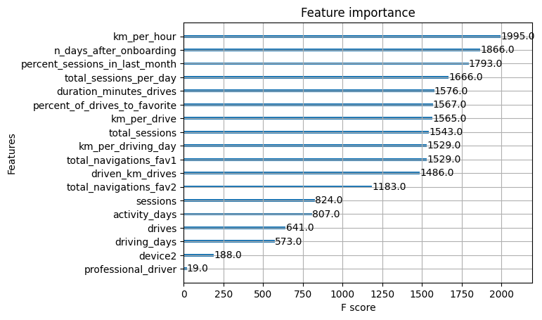
User Churn Project | ML Model Results
🚦 Project Update – Milestone 6 The Waze data team is advancing its analytics initiative to reduce monthly user churn, defined as users who uninstall or stop using the app.
The long-term objective is to build a machine learning (ML) model capable of predicting churn. This report summarizes findings from Milestone 6, highlighting insights that could guide future development and modeling efforts.
To maximize predictive accuracy, the Waze data team developed and compared two models: Random Forest and XGBoost.
The data was split into training, validation, and test sets. While this three-way split reduces the amount of data available for training compared to a two-way split, it allows independent model selection on the validation set. The final model can then be evaluated on the test set, providing a more reliable estimate of its future performance.
Key Insights – Milestone 6
Data limitations: The current dataset is insufficient to reliably predict user churn.
Additional data needs:Drive-level information (e.g., drive times, geographic locations) for each user. More granular app interaction data (e.g., frequency of reporting or confirming road hazards). Monthly counts of unique starting and ending locations per driver.
Feature engineering: Engineered features remain a valuable tool for improving model performance.
Recommendation: The Waze team suggests a second iteration of the User Churn Project, incorporating additional data and feature engineering to strengthen predictive accuracy.
Feature importance: Engineered features dominated the top predictors, with six of the top ten features being engineered: km_per_hour, percent_sessions_in_last_month, total_sessions_per_day, percent_of_drives_to_favorite, km_per_drive, and km_per_driving_day.
Model comparison: XGBoost outperformed the Random Forest model in fitting the data.
Improved recall: The XGBoost model achieved a recall of 17%, nearly double the score of the logistic regression model from Milestone 5, while maintaining similar accuracy and precision. Advantages of tree-based ensembles: These models deliver higher performance across metrics and require less data preprocessing compared to logistic regression.
Tradeoff: Tree-based models are less interpretable, making it harder to understand the exact reasoning behind predictions.

